Slide 1
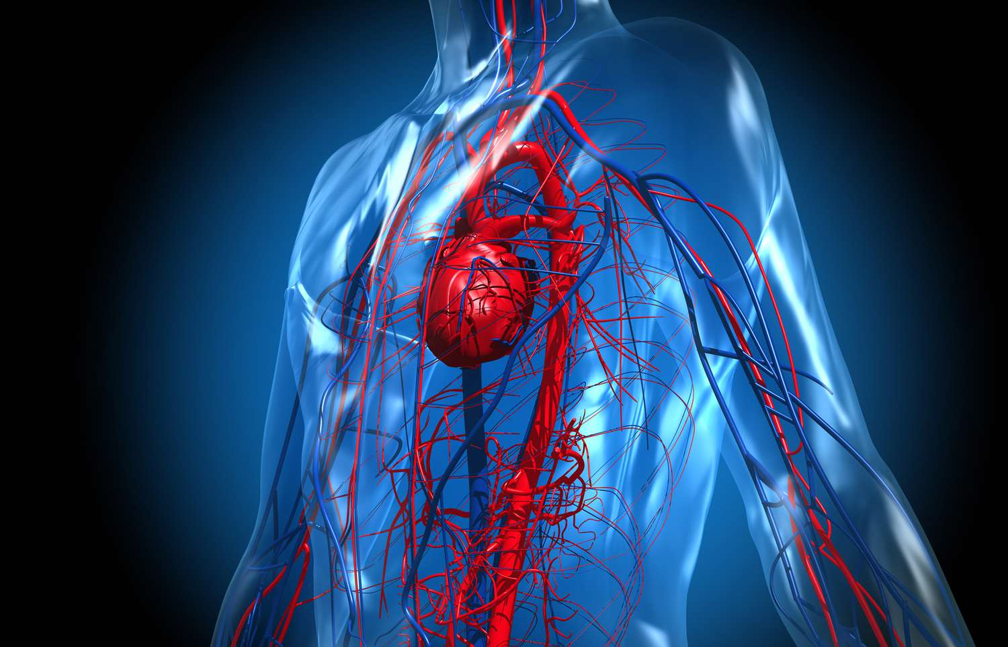
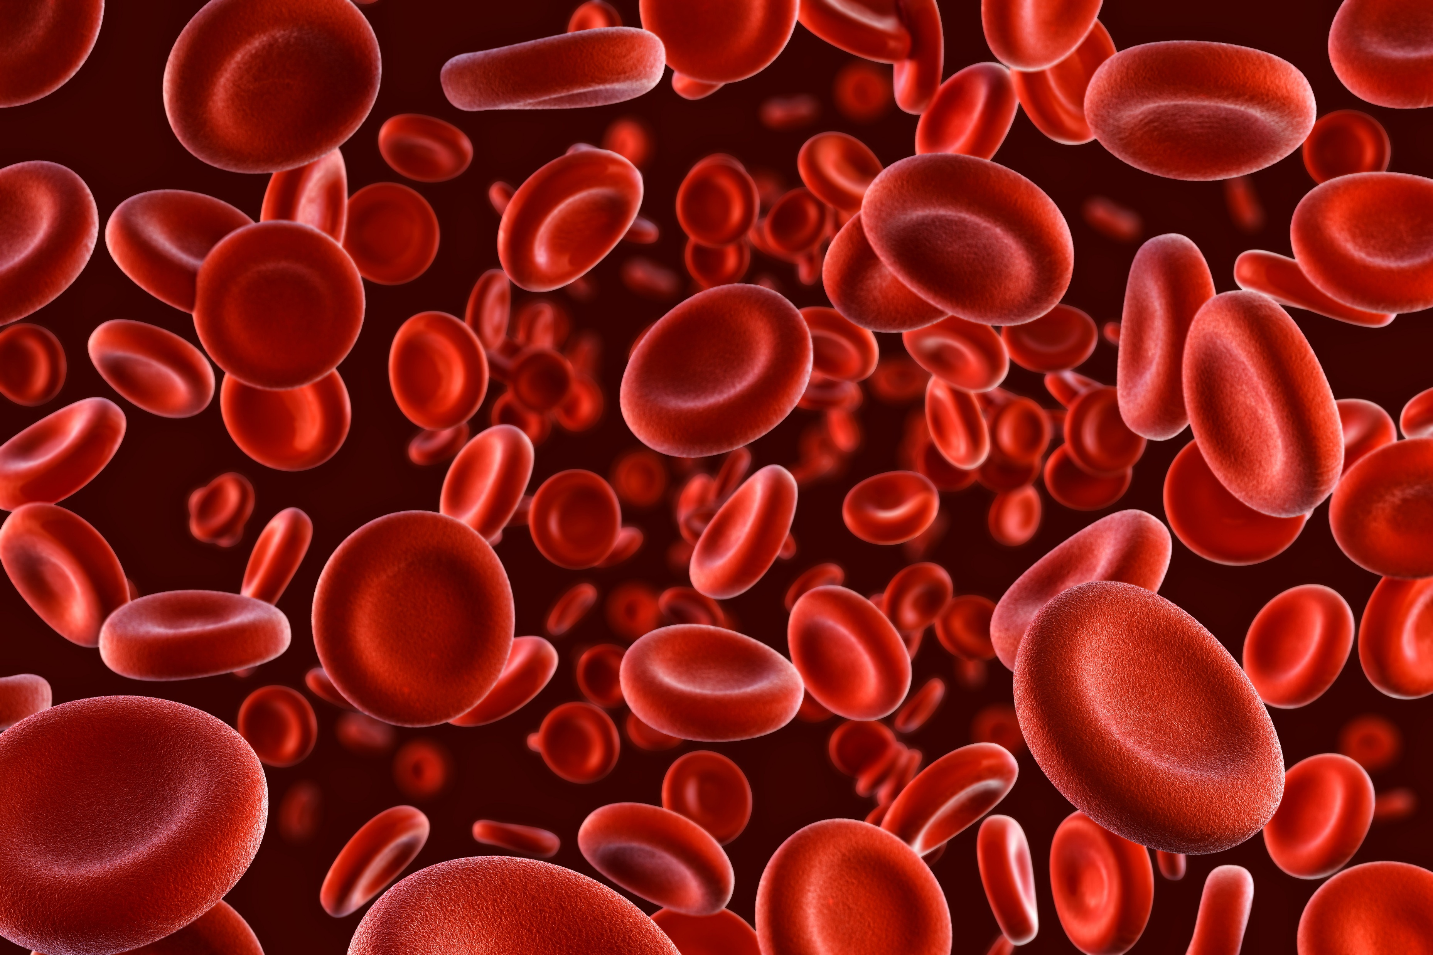

GROUP - 08

Slide 2
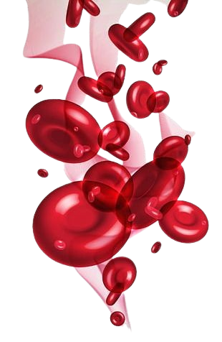
GROUP - 08
AKSHAI S.
MURALEETHARAN P.
PUSHPAKUMARA M.G.P
ASANGI A.A.S
MALLAWA M.T.D.T
KODITHUWAKKU K.A.P.T
NIDHUSHA A.
IHSAAN T.M
ABEYSEKARA Y.K.I
GWU/BAMS/2023/076
GWU/BAMS/2023/077
GWU/BAMS/2023/078
GWU/BAMS/2023/079
GWU/BAMS/2023/080
GWU/BAMS/2023/081
GWU/BAMS/2023/082
GWU/BAMS/2023/086
GWU/BAMS/2023/087

Slide 3
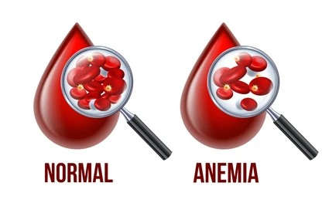
Introduction
What is Anemia?
A blood disorder that occurs when the body doesn’t produce enough healthy red blood cells (RBC) or the red blood cells aren’t functioning properly.
Normal Hemoglobin Levels
Adult Males: 13.5 – 17.5 g/dL
Adult Females: 12.0 – 15.5 g/dL

Slide 4
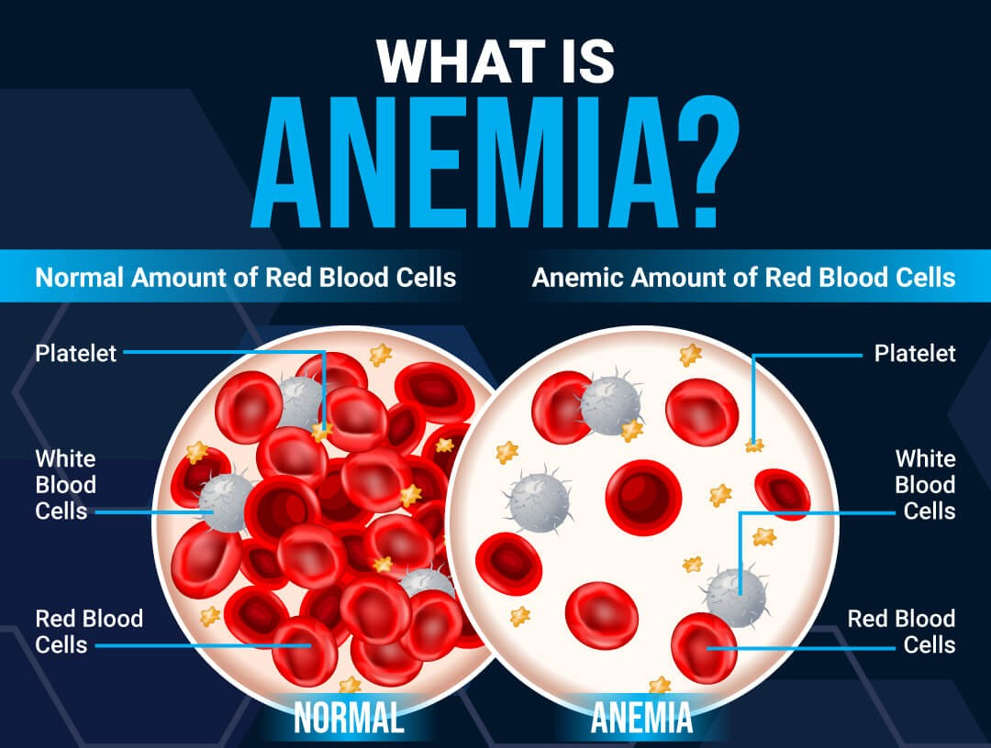

Slide 5
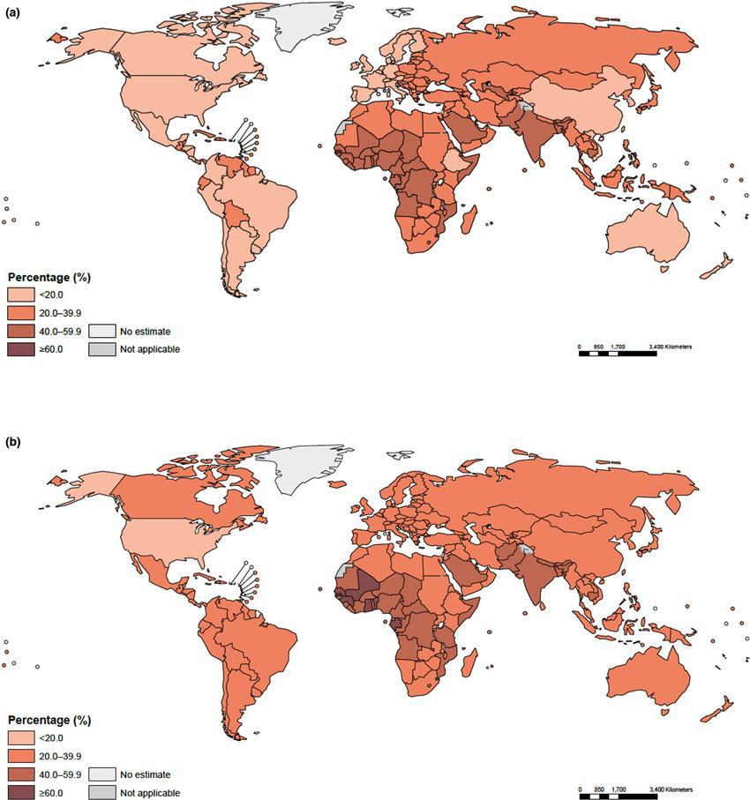
Epidemiology & Risk Factors
Global Prevalence
High prevalence in low- and middle-income countries
Regional variations
Most Affected Groups
Children under 5 years
Pregnant women
Women of reproductive age
Frequent blood donors
Vegetarians & vegans

Slide 6
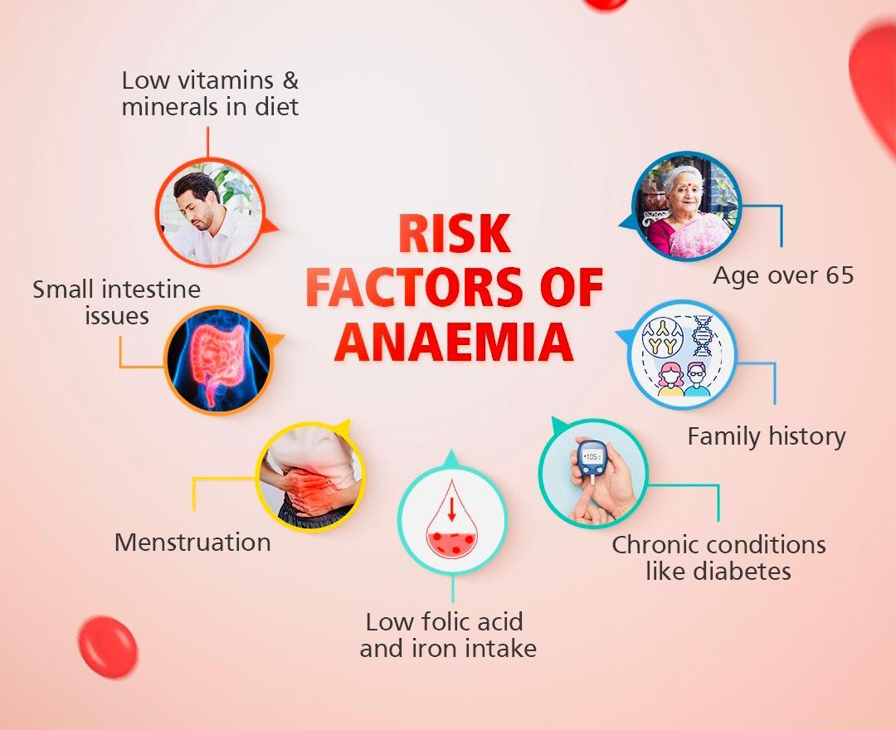
Risk Factors

Slide 7
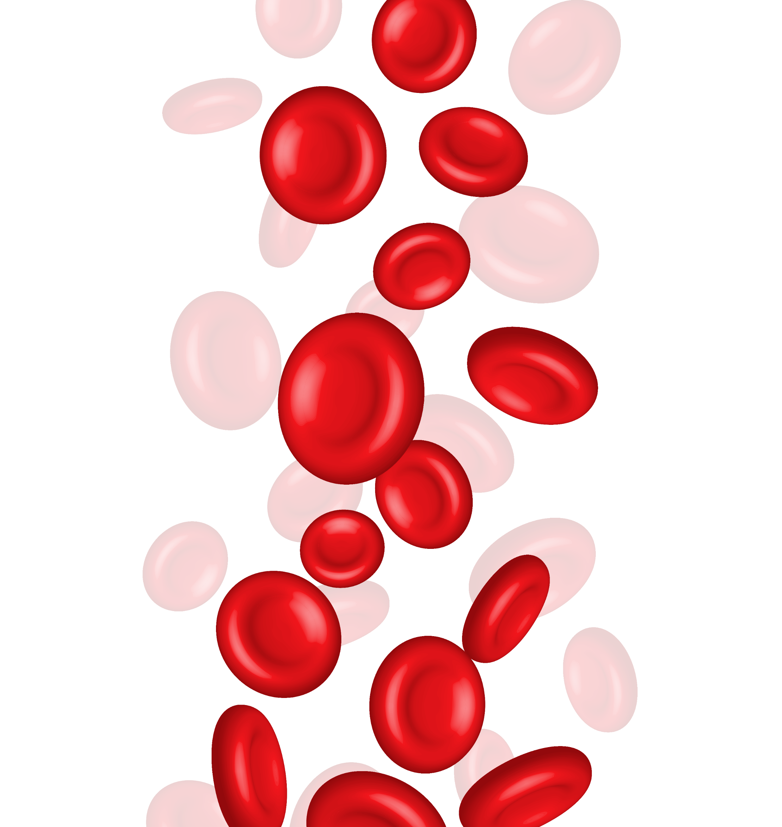
Etiology / Causes of Anemia
1. Blood Loss
Heavy menstruation
Injury or surgery
Gastrointestinal bleeding (Ulcers, Hemorrhoids)
3. Increased Red Blood Cell
Destruction
Genetic conditions (Sickle cell anemia, Thalassemia)
Autoimmune disorders
Infections
Certain medications
2. Decreased Red Blood Cell
Production
Iron deficiency
Vitamin B12 / folic acid deficiency
Bone marrow disorders
Chronic diseases (Kidney disease)

Slide 8
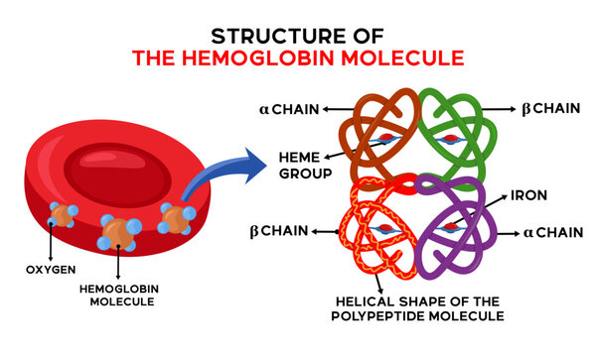
Pathophysiology
RBC & Hemoglobin (in relation to Anemia)
Biconcave shape → increases surface area for oxygen exchange
No nucleus & no organelles → more room for hemoglobin
Lifespan: about 120 days
Produced in bone marrow (erythropoiesis)
RBCs transport O₂ through Hemoglobin (Hb)
↓ Red blood cells (RBCs) or ↓ Hemoglobin
Causes: blood loss, RBC destruction (hemolysis), ↓ RBC production (nutrient or marrow problem)

Slide 9

Effect on Oxygen Transport
RBCs = “trucks” carrying oxygen
Hemoglobin = iron-containing protein inside RBCs.
Low iron → low hemoglobin → less oxygen transport.
Fewer/abnormal RBCs or low Hb → anemia.
Leads to fatigue, weakness, pallor, shortness of breath.
Body’s Compensatory Mechanisms
↑ Heart rate & cardiac output
↑ Breathing rate
• Kidneys → more erythropoietin (EPO) → stimulate RBC production
Oxygen saved for vital organs (brain, heart)

Slide 10
Classification of Anemia
Anemia
Aetiological
Decreased RBC production
Increased RBC destruction
Morphological
Microcytic anemia
Abnormal blood lose
Normocytic anemia
Macrocytic anemia

Slide 11
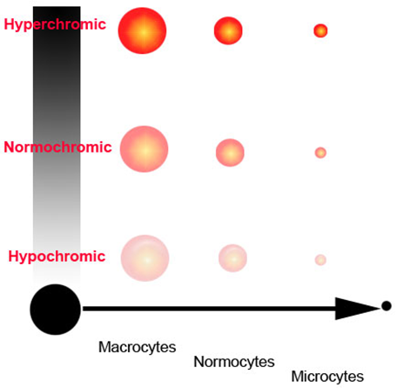
Morphological Classification
Macrocytic anemia
(Hyperchromic)
mcv > 100fL
Normocytic anemia
(Normochromic)
normal mcv ( 76 - 96fL)
Microcytic anemia
(Hypochromic)
mcv < 80fL

Slide 12
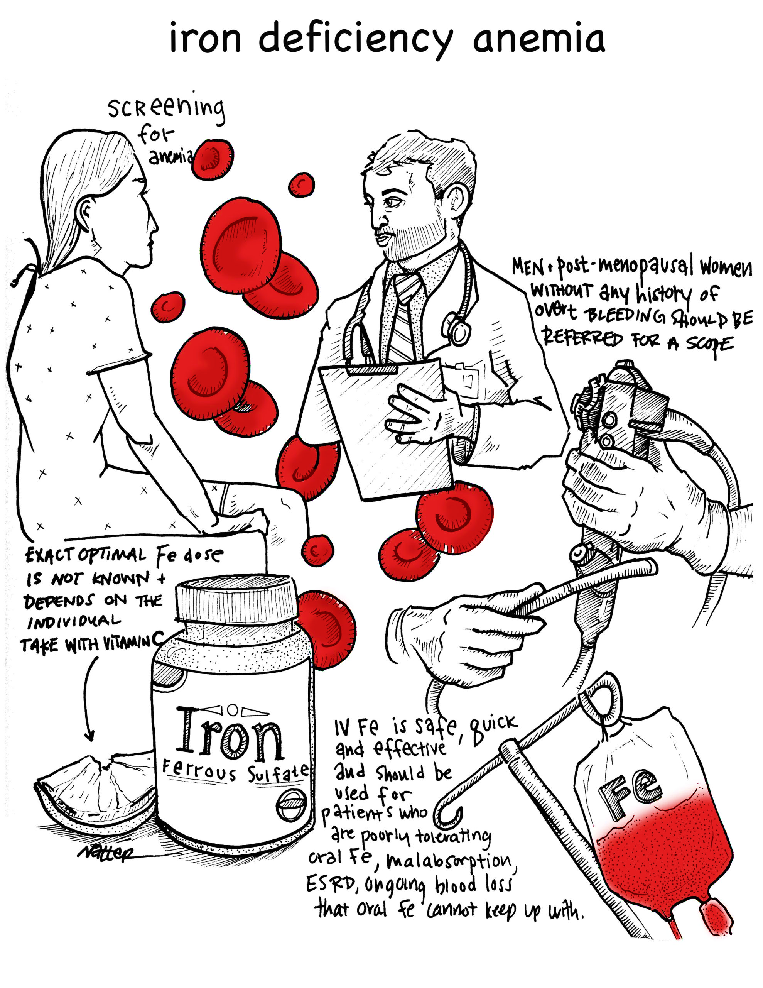
Iron Deficiency Anemia
What it is
A lack of iron leads to too small amount of Hemoglobin, causing reduced oxygen supply to the body.
Causes
Low dietary intake of iron
Increased iron requirement (Pregnancy)
Blood loss (Menorrhagia, Hemorrhoids)
Poor absorption of iron
Small intestine issues
Excess tea/coffee intake

Slide 13
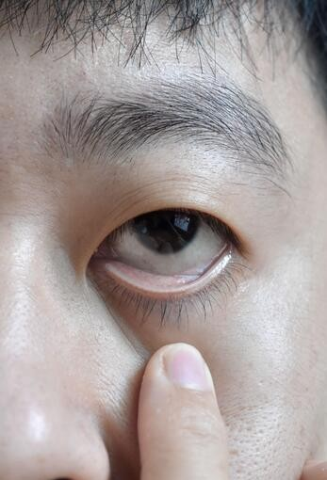
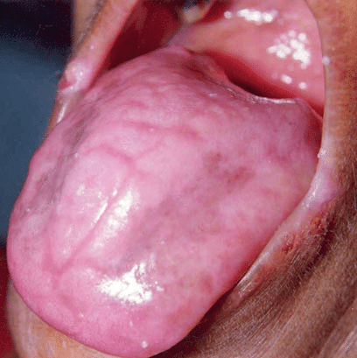
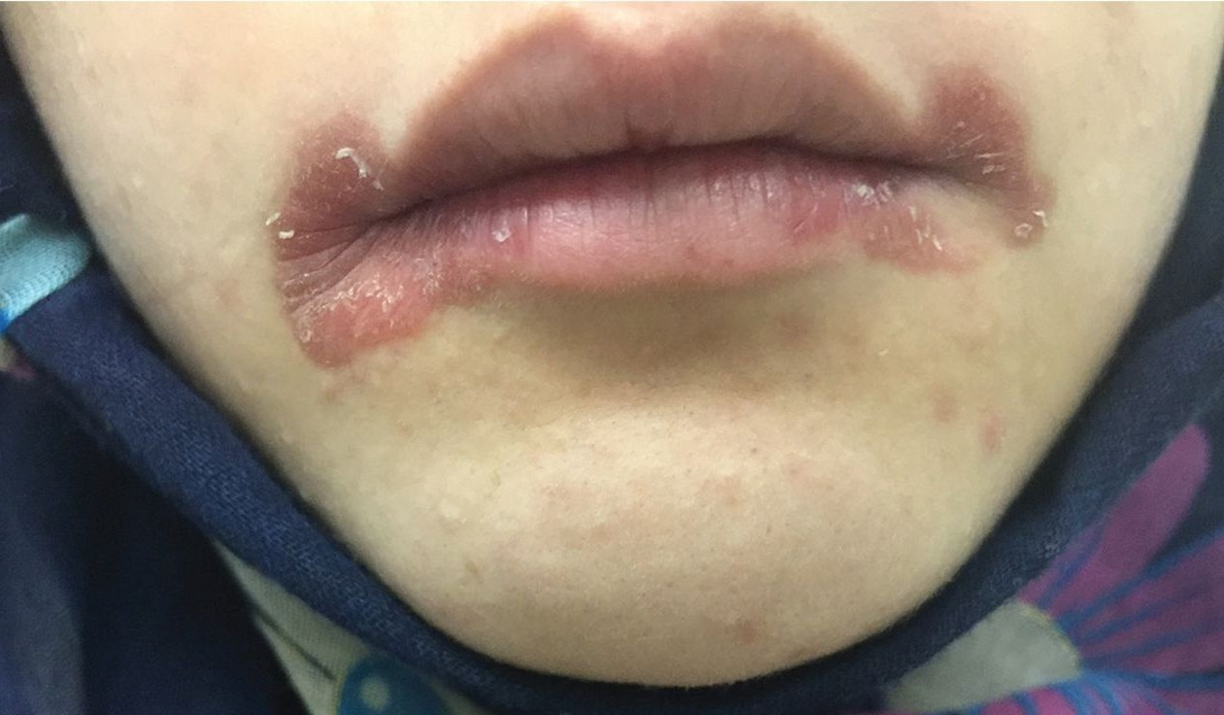
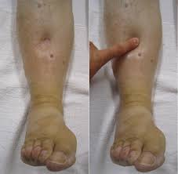
Clinical Features
Signs
Symptoms
Pallor (pale skin, lips)
Koilonychia (spoon-shaped nails)
Glossitis (smooth, sore tongue)
Edema
Fast heartbeat
Fatigue & weakness
Shortness of breath, dizziness
Cold hands & feet
Headaches
Craving noon-food items

Slide 14
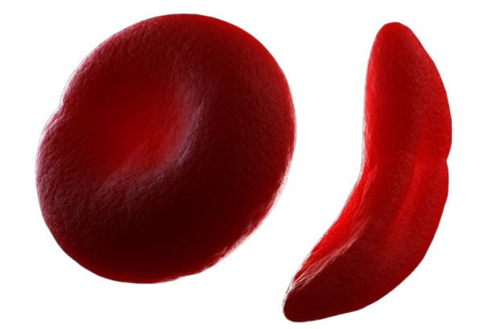
Diagnosis
Treatments
Prevention
Full blood count (FBC)
Serum ferritin
Serum iron & transferrin saturation
Total iron-binding capacity (TIBC)
Dietary modifications
Iron supplements
Severe cases
Intravenous (IV) iron therapy.
Blood transfusion (if life-threatening anemia).
Treating underlying cause
Controlling menstrual bleeding.
Treating ulcers or GI bleeding.
Correcting malabsorption issues.
Balanced diet with enough iron and folate.
Iron supplements during pregnancy.
Regular screening for at-risk groups (women, children, elderly).
Treating early signs of blood loss (e.g., ulcers, heavy menstruation).

Slide 15
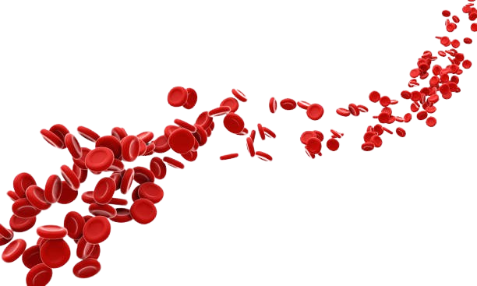
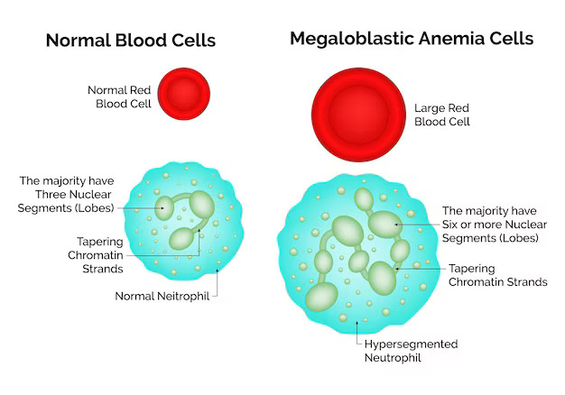
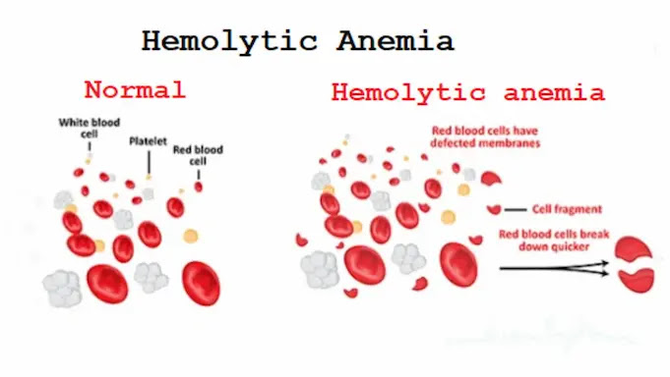
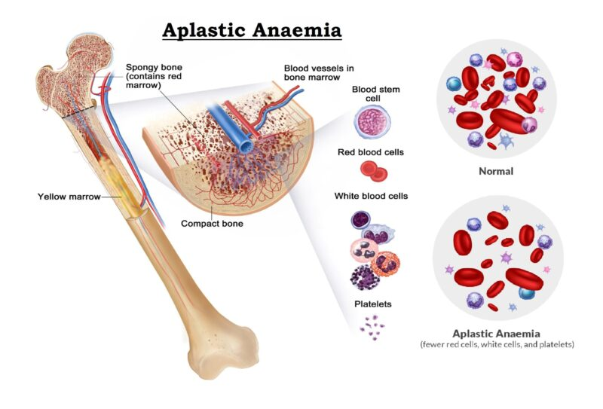
Anemia Types (Uncommon)
Megaloblastic Anemia
Hemolytic Anemia
Aplastic Anemia
Sickle Cell Anemia
Anemia Types (Uncommon)
Types
Megaloblastic Anemia
Hemolytic Anemia
Sickle Cell Anemia
Aplastic Anemia
Megaloblastic Anemia
A type of anemia caused by impaired DNA synthesis, leading to large, immature RBCs (megaloblasts).
Hemolytic Anemia
Anemia due to increased destruction of RBCs.
Aplastic Anemia
A condition that happens when your bone marrow stops making enough new blood cells.
Sickle Cell Anemia
A serious, inherited blood disorder where the body's red blood cells, which normally carry oxygen, are misshapen into a crescent or "sickle" form due to abnormal hemoglobin.

Slide 16
Anemia Types (Uncommon)
Megaloblastic Anemia
Hemolytic Anemia
Aplastic Anemia
Sickle Cell Anemia
Megaloblastic Anemia
A type of anemia caused by impaired DNA synthesis, leading to large, immature RBCs (megaloblasts).
Types
Anemia Types (Uncommon)
Megaloblastic Anemia
Hemolytic Anemia
Aplastic Anemia
Sickle Cell Anemia
Hemolytic Anemia
Anemia due to increased destruction of RBCs.
Aplastic Anemia
A condition that happens when your bone marrow stops making enough new blood cells.
Sickle Cell Anemia
A serious, inherited blood disorder where the body's red blood cells, which normally carry oxygen, are misshapen into a crescent or "sickle" form due to abnormal hemoglobin.

Slide 17
Anemia Types (Uncommon)
Megaloblastic Anemia
Hemolytic Anemia
Aplastic Anemia
Sickle Cell Anemia
Megaloblastic Anemia
A type of anemia caused by impaired DNA synthesis, leading to large, immature RBCs (megaloblasts).
Types
Hemolytic Anemia
Anemia due to increased destruction of RBCs.
Megaloblastic Anemia
Anemia Types (Uncommon)
Hemolytic Anemia
Aplastic Anemia
Sickle Cell Anemia
Aplastic Anemia
A condition that happens when your bone marrow stops making enough new blood cells.
Sickle Cell Anemia
A serious, inherited blood disorder where the body's red blood cells, which normally carry oxygen, are misshapen into a crescent or "sickle" form due to abnormal hemoglobin.

Slide 18
Anemia Types (Uncommon)
Megaloblastic Anemia
Hemolytic Anemia
Aplastic Anemia
Sickle Cell Anemia
Megaloblastic Anemia
A type of anemia caused by impaired DNA synthesis, leading to large, immature RBCs (megaloblasts).
Hemolytic Anemia
Anemia due to increased destruction of RBCs.
Types
Megaloblastic Anemia
Aplastic Anemia
A condition that happens when your bone marrow stops making enough new blood cells.
Hemolytic Anemia
Anemia Types (Uncommon)
Aplastic Anemia
Sickle Cell Anemia
Sickle Cell Anemia
A serious, inherited blood disorder where the body's red blood cells, which normally carry oxygen, are misshapen into a crescent or "sickle" form due to abnormal hemoglobin.

Slide 19
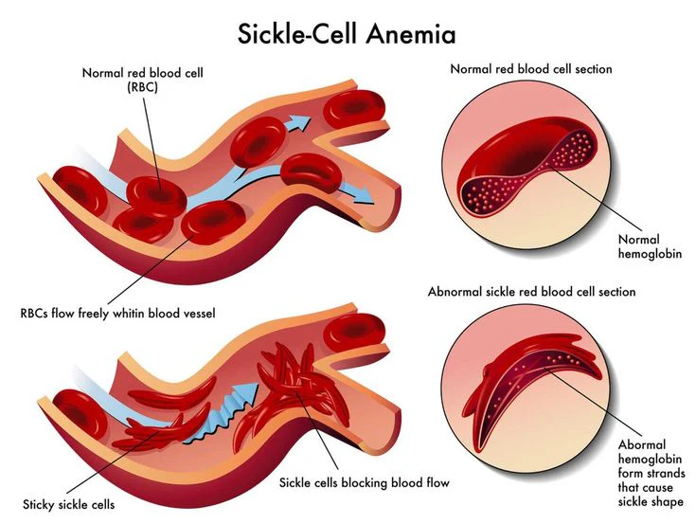
Anemia Types (Uncommon)
Megaloblastic Anemia
Hemolytic Anemia
Aplastic Anemia
Sickle Cell Anemia
Megaloblastic Anemia
A type of anemia caused by impaired DNA synthesis, leading to large, immature RBCs (megaloblasts).
Hemolytic Anemia
Anemia due to increased destruction of RBCs.
Aplastic Anemia
A condition that happens when your bone marrow stops making enough new blood cells.
Megaloblastic Anemia
Types
Hemolytic Anemia
Sickle Cell Anemia
A serious, inherited blood disorder where the body's red blood cells, which normally carry oxygen, are misshapen into a crescent or "sickle" form due to abnormal hemoglobin.
Aplastic Anemia
Anemia Types (Uncommon)
Sickle Cell Anemia

Slide 20
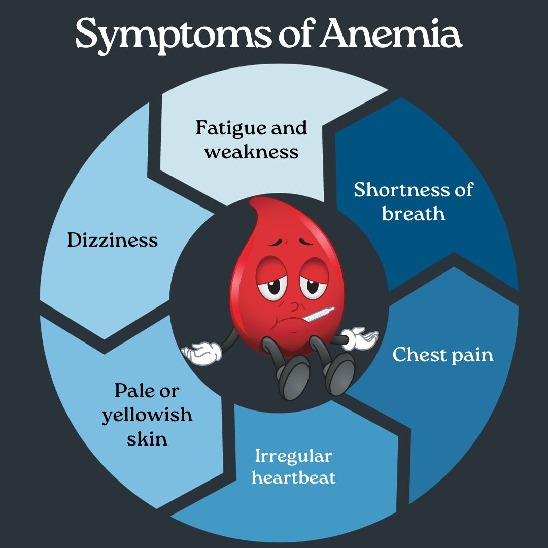
Clinical Features
General Signs
Pallor – conjunctiva, tongue, nail beds, palms
Tachycardia, flow murmurs
Cold extremities
Specific Features (According to Type)
Megaloblastic Anemia → Beefy red tongue, neurological symptoms (tingling, ataxia, memory loss)
Hemolytic Anemia → Jaundice, dark urine, splenomegaly
Aplastic Anemia → Infections, bleeding tendencies (petechiae, purpura)
General Symptoms
Fatigue & Weakness
Easy tiredness
Shortness of breath on exertion
Palpitations, Headache, Dizziness

Slide 21
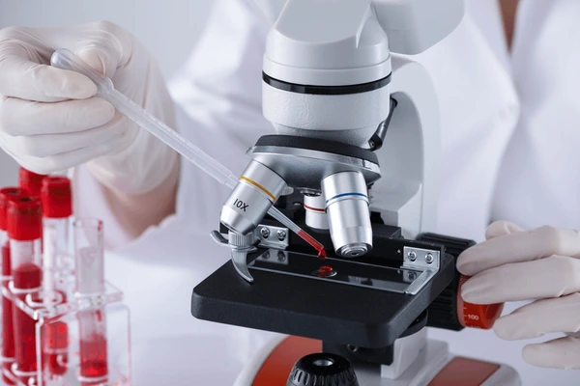
Diagnosis of Anemia
1. History & Examination
Symptoms: fatigue, breathlessness, palpitations
Signs: pallor, tachycardia, nail/tongue changes, splenomegaly, jaundice
2. Laboratory Investigations
Complete Blood Count (CBC)
↓ Hemoglobin, ↓ Hematocrit
RBC indices (MCV, MCH, MCHC) → classify anemia
Peripheral Blood Smear → morphology of RBCs
Reticulocyte Count → marrow activity
Iron Studies → serum iron, ferritin, TIBC
Vitamin B12 & Folate levels
Hemolysis work-up → LDH, bilirubin, Coombs test
Bone marrow examination (if needed)

Slide 22
Management of Anemia
General
Principles
Treat the Cause
Prevent Recurrence
Correct Anemia Safely

Slide 23
Specific Management
1. Iron Deficiency Anemia
Oral iron therapy (ferrous sulfate, gluconate)
Treat cause (bleeding, diet correction, deworming)
2. Megaloblastic Anemia
Vitamin B12 injections (cyanocobalamin / hydroxocobalamin)
Folic acid supplementation
4. Aplastic Anemia
Immunosuppressive therapy
Bone marrow transplant
3. Hemolytic Anemia
5. Severe Anemia (Hb very low)
Treat underlying cause (e.g., infection, autoimmune)
Folic acid, steroids, splenectomy if indicated
Blood transfusion (packed RBCs)

Slide 24
REFERENCES
Hoffbrand, A. V., & Moss, P. A. H. (2019). Essential Haematology (8th ed.). Wiley-Blackwell.
World Health Organization (WHO). (2023). Anemia. Retrieved from https://www.who.int/health-topics/anaemia
Cappellini, M. D., Motta, I. (2015). Anemia in clinical practice—definition and classification: Does hemoglobin change with aging? Seminars in Hematology, 52(4), 261–269.
Camaschella, C. (2015). Iron-deficiency anemia. New England Journal of Medicine, 372(19), 1832–1843.
Rodak, B. F., Fritsma, G. A., & Keohane, E. M. (2020). Hematology: Clinical Principles and Applications (6th ed.). Elsevier.

Slide 25
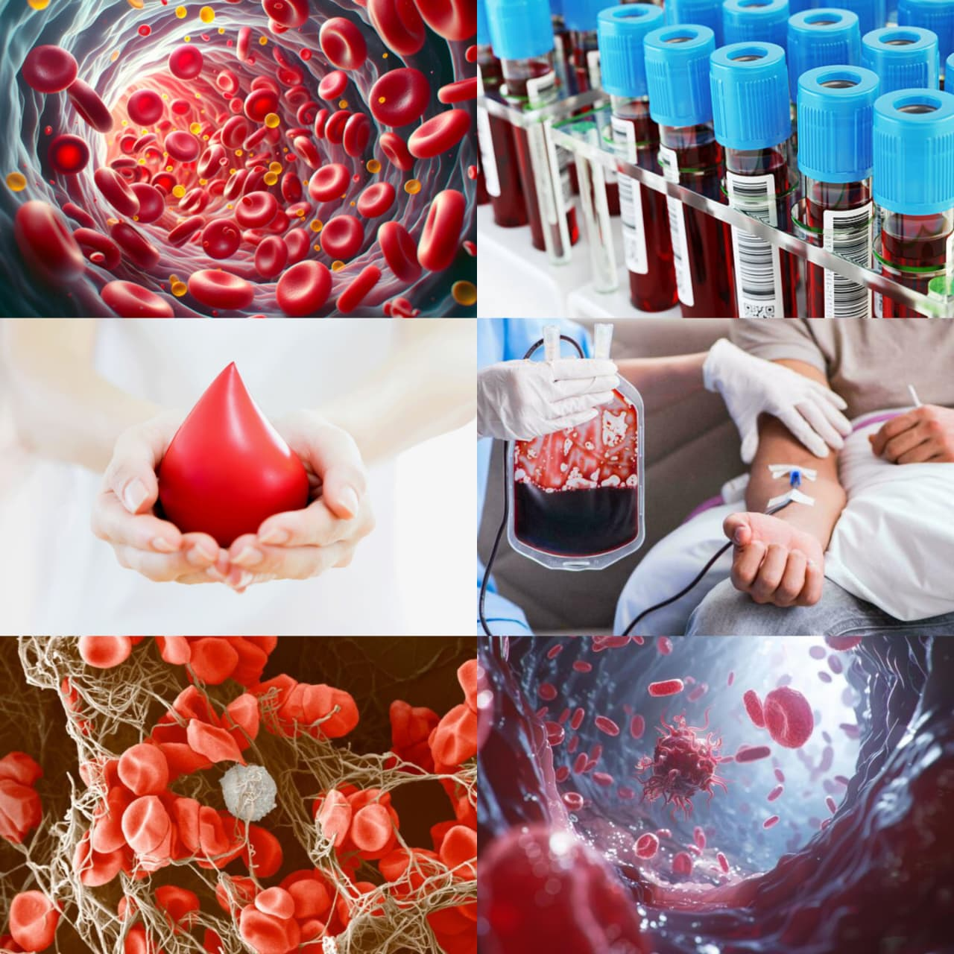
THANK YOU

